Slide 1

Library Management System
S.E.A.L BLUE TEAM
By Jackson Schmidt,
Julian Christian,
Mikayla Thornton,
Dylan Ponder

Slide 2
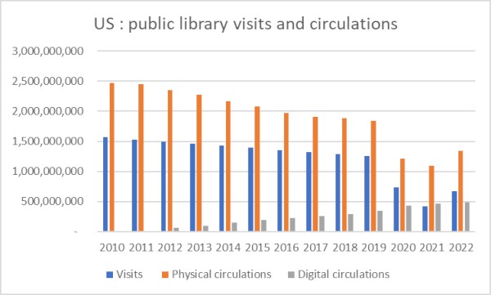
Modern Library Dilemma
1
Defining the problem
Engagement Issues:
-Visitation Decreasing
-Low circulation (borrows)
Operational Challenges:
-Grant Losses
-Lack of online accessibility
-Manual work overload
source: Publishers Weekly
Notes:
S1: "Libraries today face more than just quiet reading rooms. They’re juggling rising patron expectations, limited staff resources, and outdated tools.
S1: "That's where we come in. Our team designed a system that streamlines library operations, improves access to key information, and strengthens accountability from top to bottom.”
S2: “Our experience with past clients has led us to believe that this system would be a perfect fit for this location and customer base”
S2: “We believe that our implementation will meet your requirements, and would like to brief you on our unique approach to database design”.
S2: "Let’s take a look at the core problems we solve."
Answer these questions:
-How we got the opportunity to create the system
-Defining the problem the system fixes - Talk about relevant slides(like what are they about)
-What our product does that others don’t

Slide 3
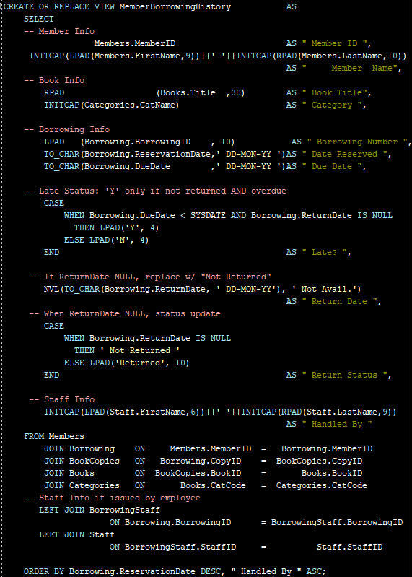
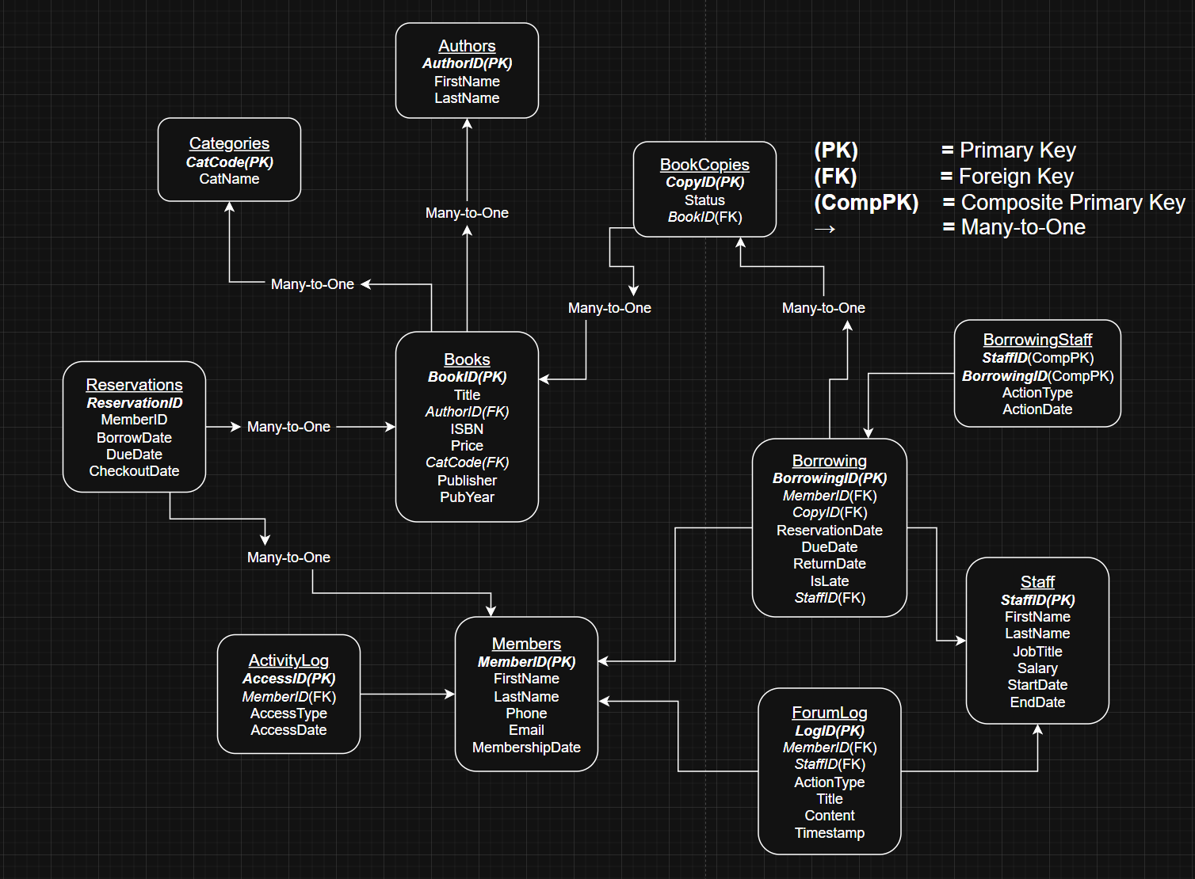
Manual Work Overload
2
“Foundation for all views and queries built upon this normalized model.”
ER Diagram
Notes:
S4: “When trying visualize relationships in a database, the most common issue most run into are not making them too complex. ER diagrams are typically used to combat this, as it functionally provides a format for which relationships between tables can be shown. When a diagram becomes too complicated, it’s unlikely to get much useful information from it.”
S4: “To avoid this common obstacle, we used naming conventions when identifying entities within relationships, added markers to indicate what type of relationship each table has with one another, and focused on removing redundancies. While researching, we began to notice a lot of issues stemmed from the lack of a solid foundation in this regard.
S3: “Countless still rely on manual tracking for borrowing, returning, and staff activity. That slows down operations and increases the risk of errors."
S3: "We addressed this by building smart table relationships and views that automate reservations, overdue tracking, and borrowing logs."
S3: "That way, staff spend less time clicking through files and more time helping their patrons."
A well-documented ER diagram illustrating the entities, attributes, and relationships
What struggles are there when trying to make an ER ?
Why ours is full coverage ?
What is the practical advantage of using an ER Diagram compared to other diagrams?

Slide 4
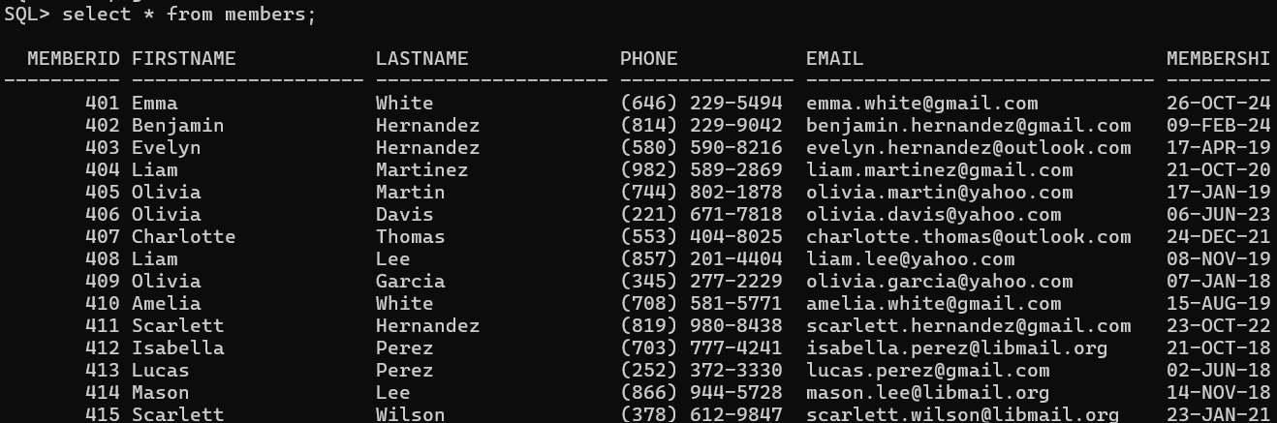
Normalization Documentation
3
Easy to follow
Cost-saving foundation
Long term maintainability
Notes:
S1: "By enforcing clean key paths, readable views, and normalized structure, we make it easy to maintain whether we’re with you long-term or you bring in your own IT team."
S1: “We always want to give you the option to work with who you want, whenever you want to.”
S1: “Not to be held back by bad design decisions and unrecognizable data.” ←this one sounds weird but phonetically it makes sense i think lol
S2: "You’re not buying a black box. You’re investing in clarity."
Explanation and documentation of the normalization process and the final normalized schema.

Slide 5
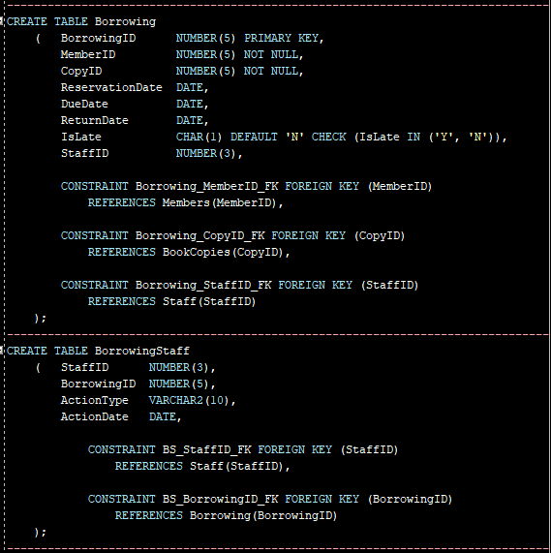
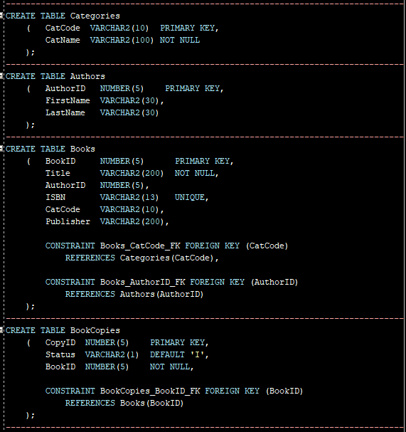
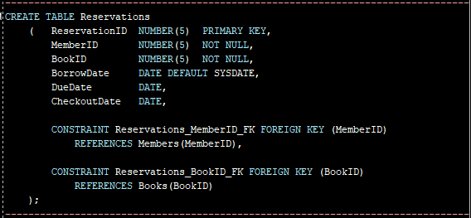
Developer-Ready Architecture
4
Concise
Real-world format
Cost efficient
Normalized Structure
Database Objects
Notes:
S4: "We want to be transparent about what’s under the hood."
S4: "We documented every table, every view, and every constraint — using real-world formatting and conventions. This means future developers aren’t stuck decoding logic or rewriting your system from scratch."
S4: “This saves you time and money in the future when trying to identify issues, and potentially can stop new ones from occurring.
S2: "It’s a system you can confidently hand off, scale up, or adapt without being locked in.
S1: A detailed schema including table structures and constraints
-
-

Slide 6
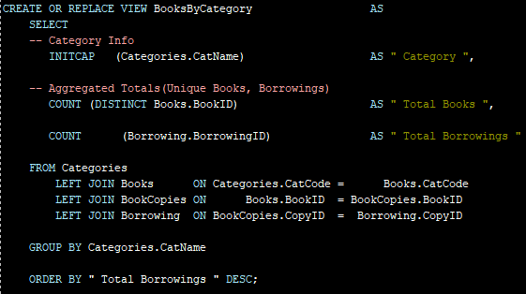
Member Borrowing Books by Category
5
Accurate
Organized
User-Friendly
Notes:
S1: "If a patron returns a book late or loses it, staff needs a fast way to check borrowing history and past issues"
S1: "With our MemberBorrowingHistory view, staff can instantly see all past loans, returns, and staff involved in each interaction.”
S1: “This will not only make your job easier by producing information in a neat orderly fashion, but also will allow the customer to leave satisfied in a hastily manner. ”
S2: “We also didn’t forget to include a Booksbycategory view, which will further allow your library to pin down what type of book is being checked out when.”
S2: “Included on the right and left are a few examples of what your library’s database will include if you decide to work with us”
S2: "Next, we want to show how this system supports general operations."
SQL Screenshots: Showing activities – (e.g., Books owed by customers, reports

Slide 7
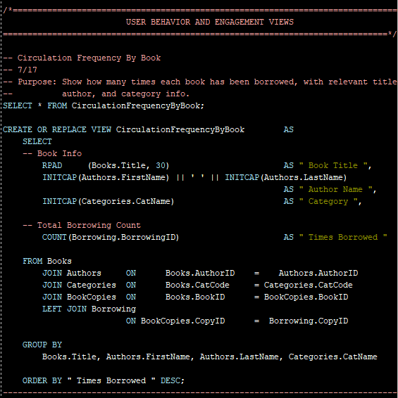
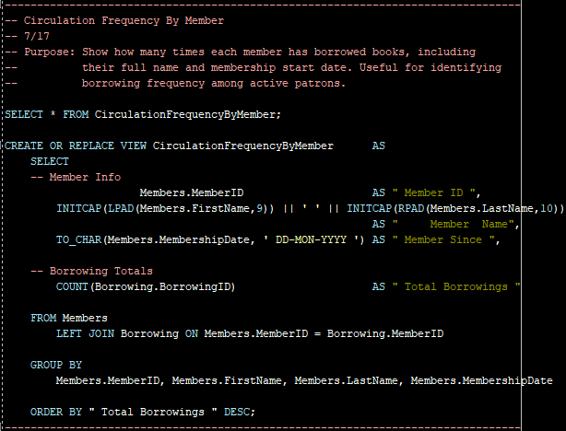
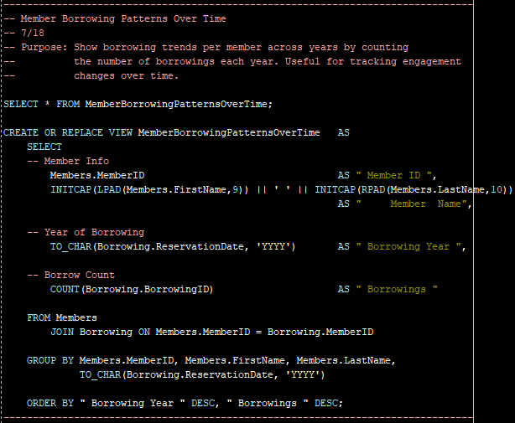
SQL Schema
6
“Smart views, smarter decisions
— SQL in action.”
Notes:
S1: "Many systems hide logic or use cryptic naming to keep clients dependent. We took the opposite route."
S1: “By using a similar format throughout the process, you will never be stuck troubleshooting on a busy day”
S2: “The goal of the views displayed here are to focus in on what your members are captivated by”
S2: “Circulation frequency by member does what it implies, allows you to see a history of repeat books checked out by customers”
S2: “Member borrowing patterns over time is the same case, further increasing the ability of your library to stay on top of trends”
S3: “We strive to give you all the tools you need to optimize your library for who makes up it’s community”
Scripts for creating the database and tables.• Scripts for inserting sample data. • SQL queries for performing operations. • SQL queries for generating reports.

Slide 8
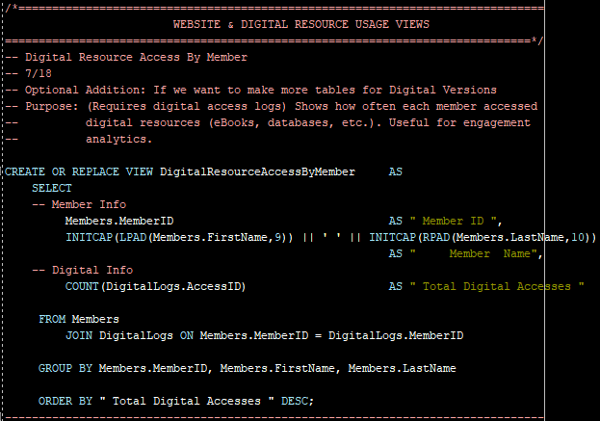
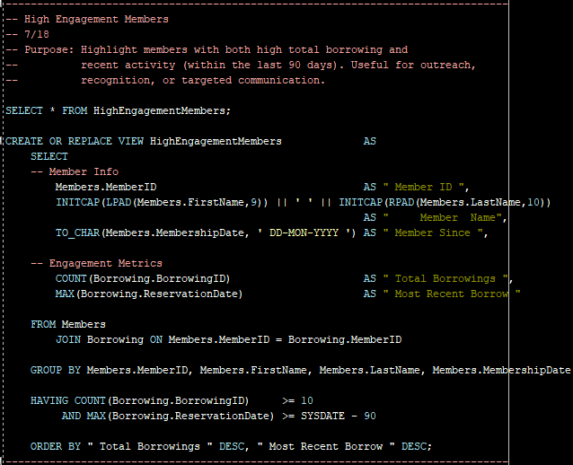
SQL Schema continued
7
Notes:
S?: “For modern libraries, we’ve got you covered as well for digital resources.”
S?: “Finding the most involved members is easy with the HighEngagementMemberview.”
S?: “Or wanting to locate specifically which members are using your digital resources, the DIgitalresourcesaccessbyMember
view solves that”
S?: “Following digital trends and record keeping are both handy, but to capitalize on either of those functions you need a practical place to use them.”

Slide 9
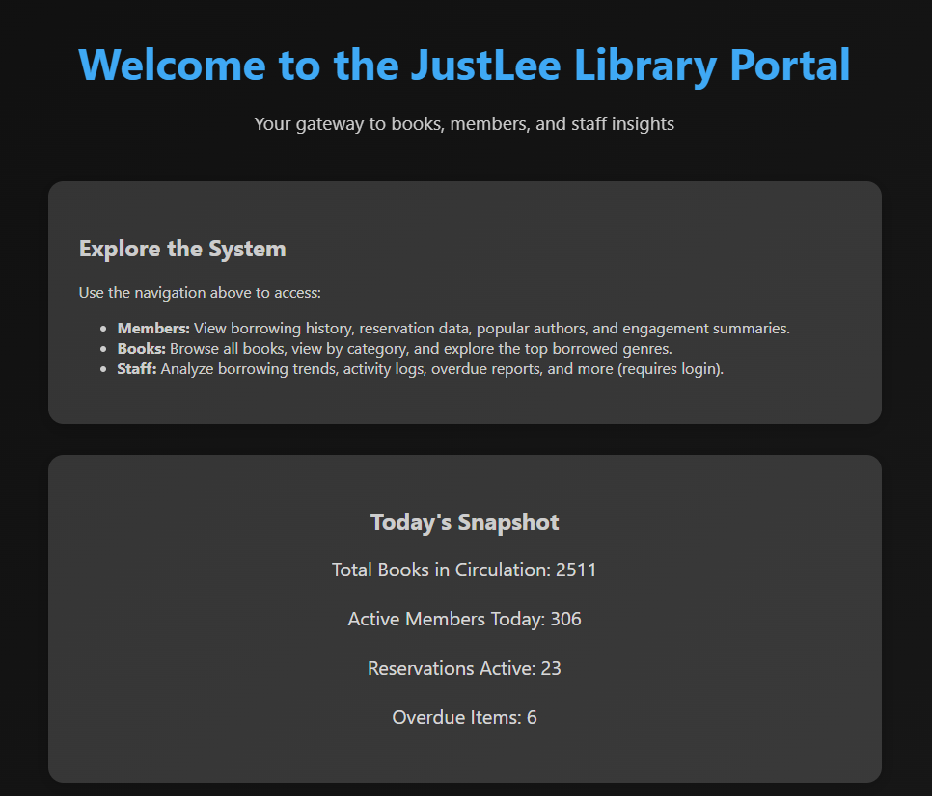
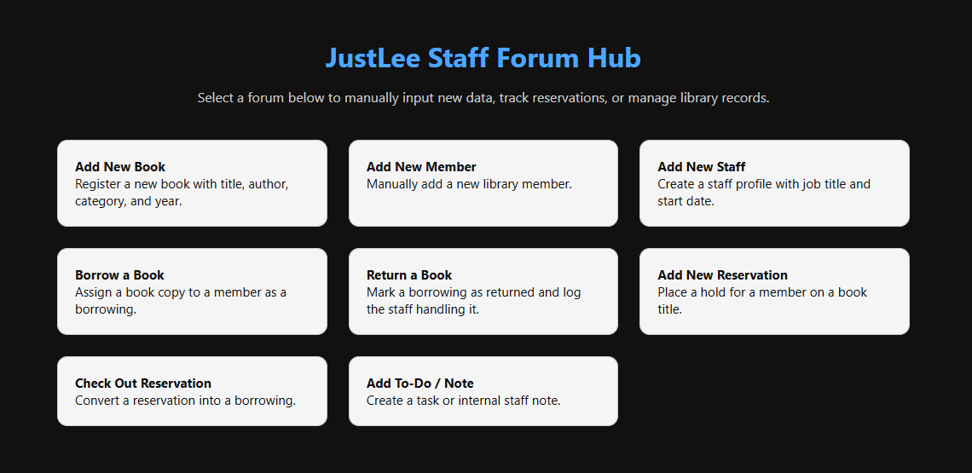
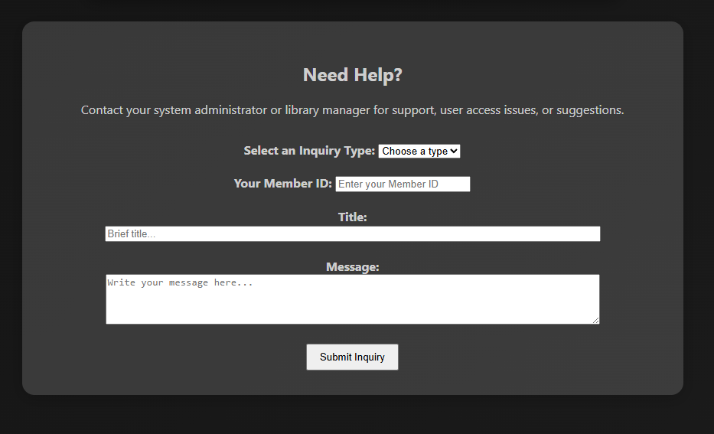
8
Notes:
S?: ”This is potentially your future database in action”
S?: “With a web portal, you will be able to access all of your libraries needs as faculty or as a member.
S?: ”This includes access to digital resources, account information, or even borrowing books”
S?: “We tried to keep the User-interface simple, but straightforward. Leaving you room to change things to the way you want them to look”

Slide 10
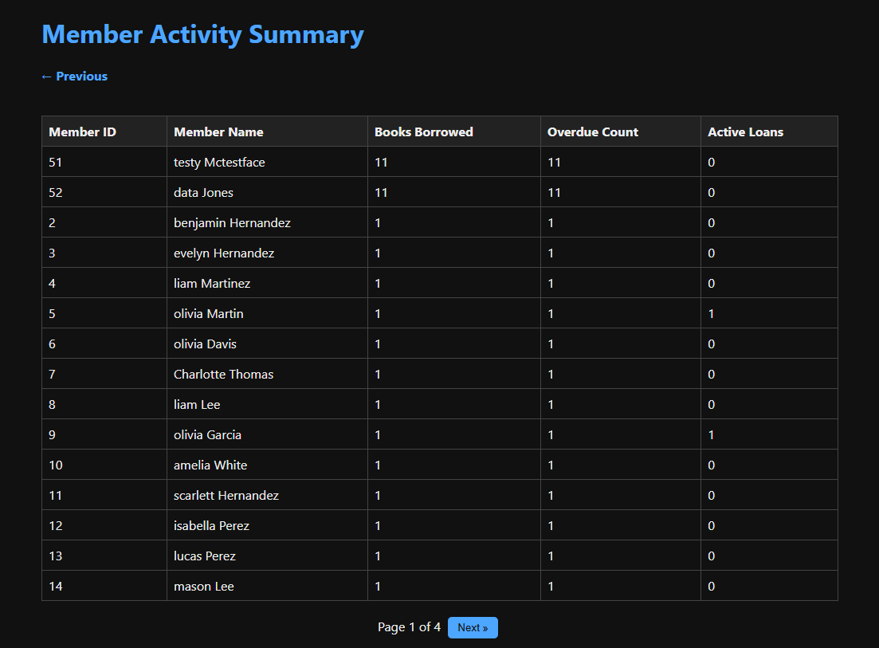
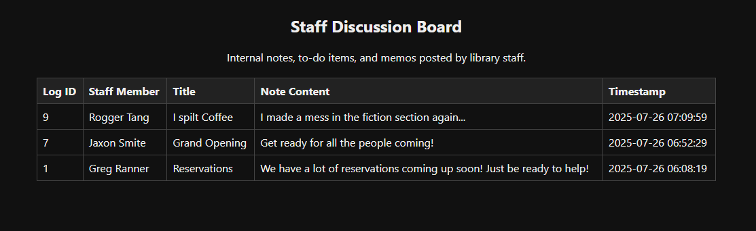
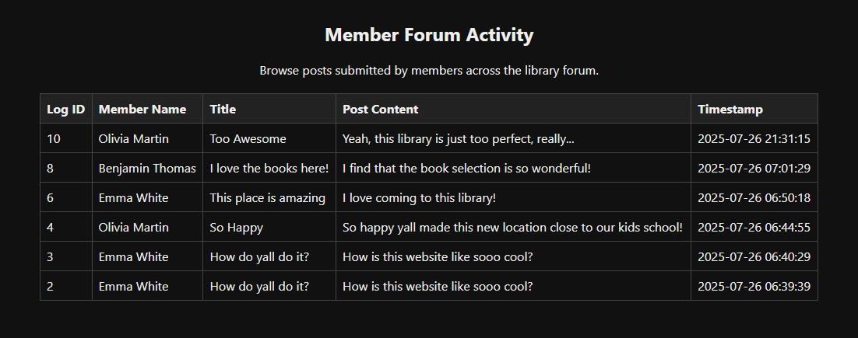
9
Community Insights
Staff Engagement
Member Input
“Together, we're writing the next chapter.”
Notes:
S?: “Like our company, your library thrives from your communities support and feedback”
S?: “Having a way for faculty and members to communicate with each other when planning events, or generally talking about library topics is crucial to your library cultivating a passionate community.
S?: “This also centralizes who is interested in your organization, meaning that discussion that may be split by different platform can meet here instead.”
S?: “Seeing which members are more active in these forums may allow you to highlight those who your library believes to be large contributors.”

Slide 11
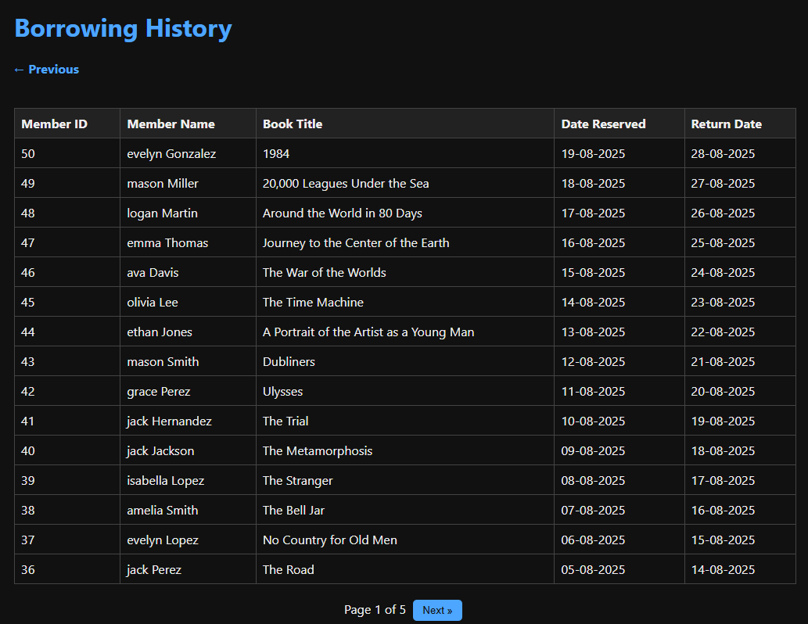
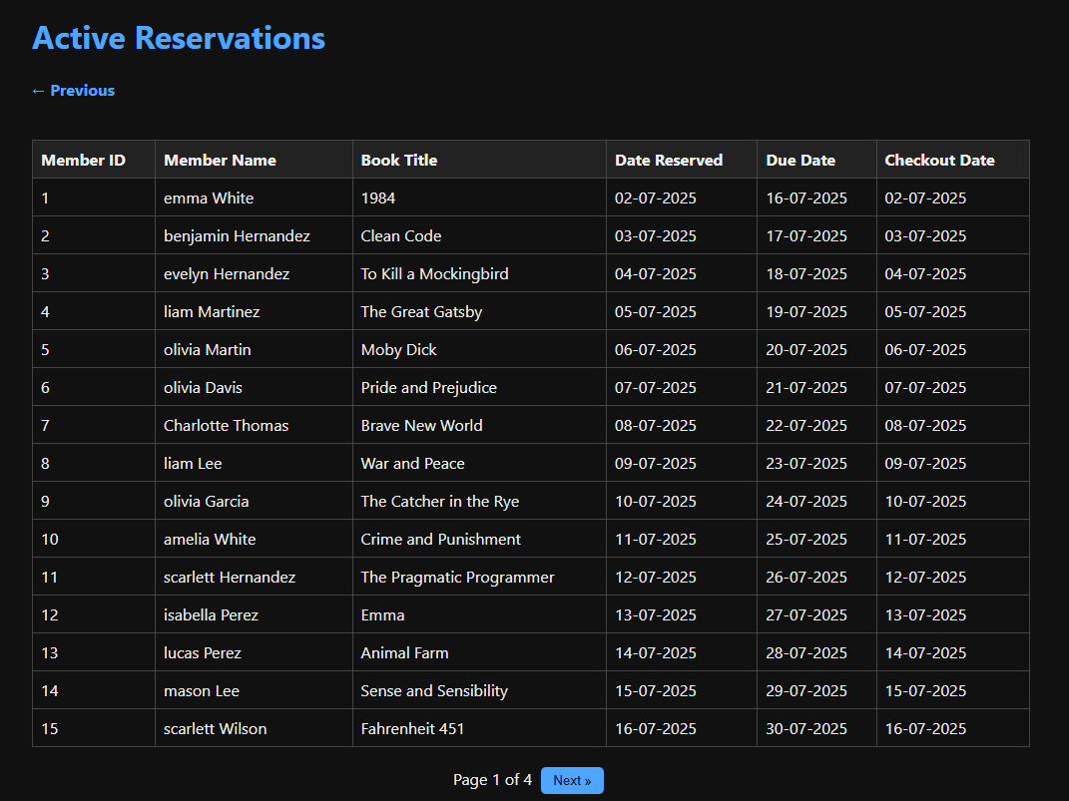
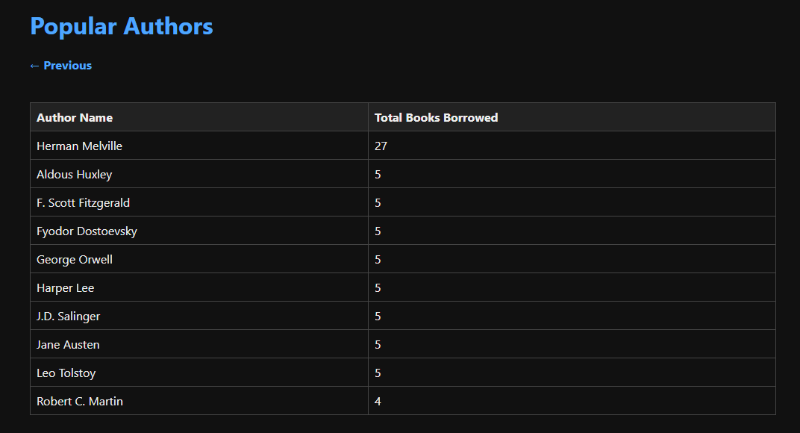
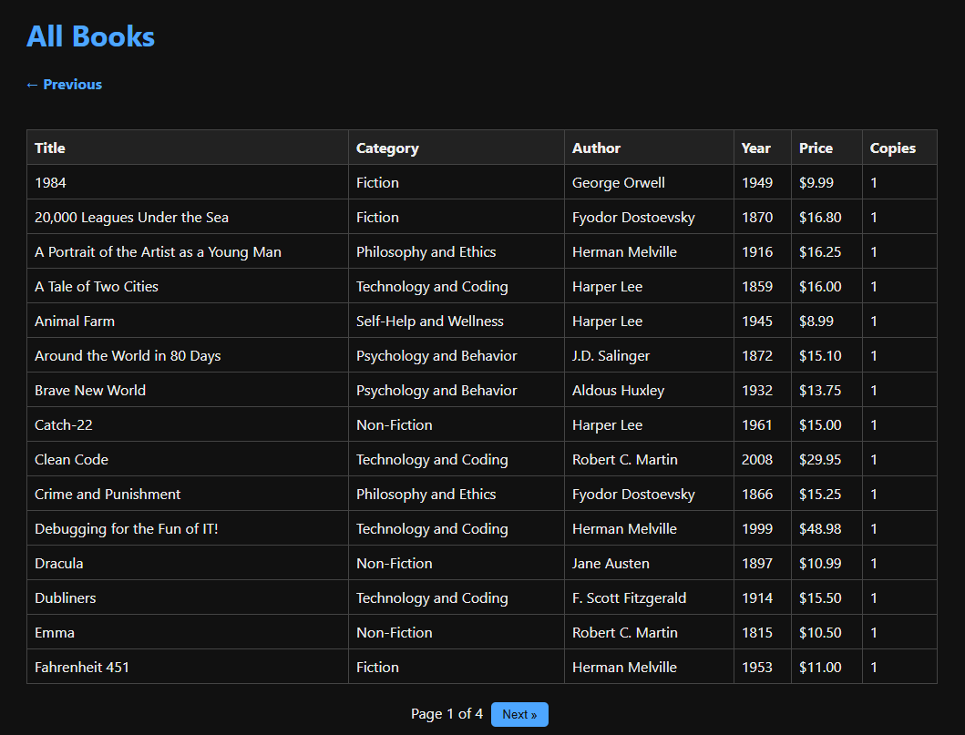
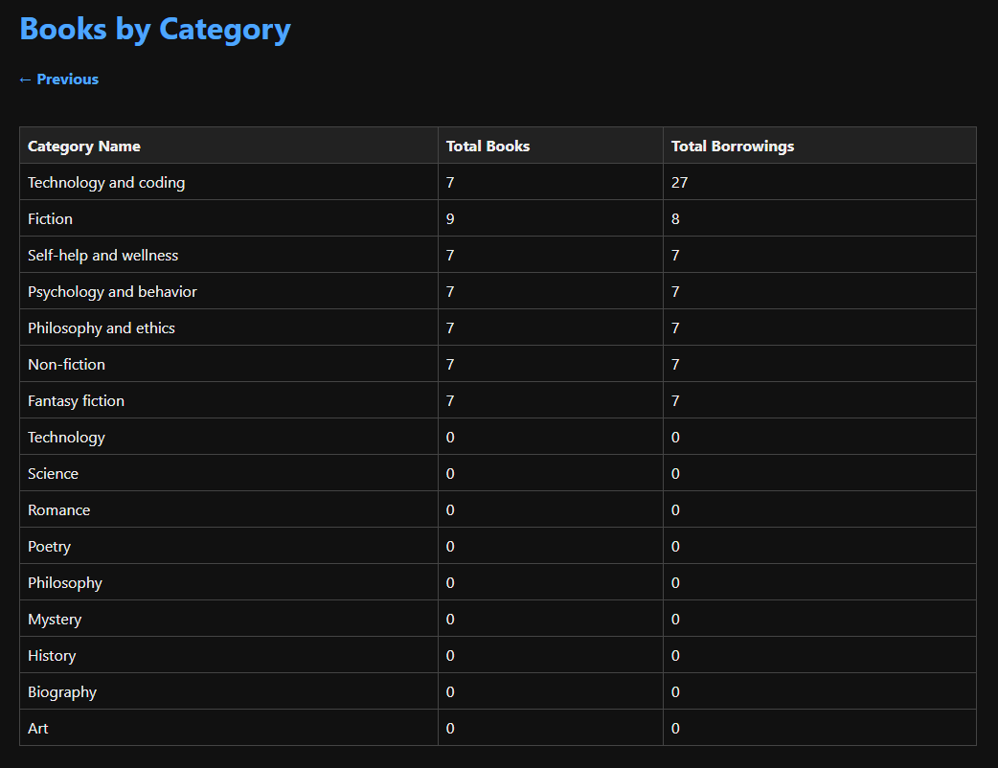
Circulation Trends
Patron Behavior
Reservation Patterns
Subject Interest
Data-Driven Insights
Strategic Collection
Notes:
S?: “Here are records displayed on the web portal”
S?: “Similar to our views, we wanted to make sure everything followed a similar format”
S?: “We wanted to make sure the records are easily readable by faculty, while also providing in-depth scope of information”
S?: “Depending on how you want to display these, your library could also easily replace columns to display information more fitting to the context of your work.”
S?: “Keeping data organized and displayed correctly is an issue of the past”

Slide 12
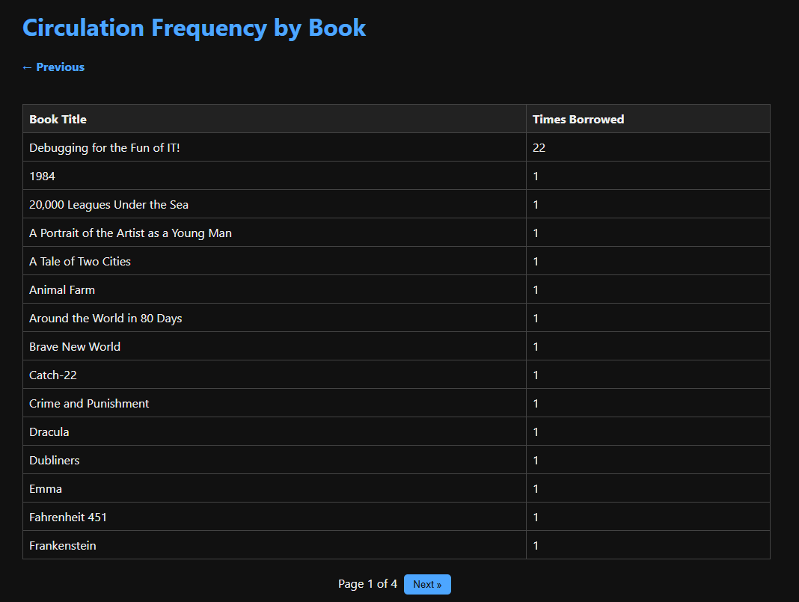
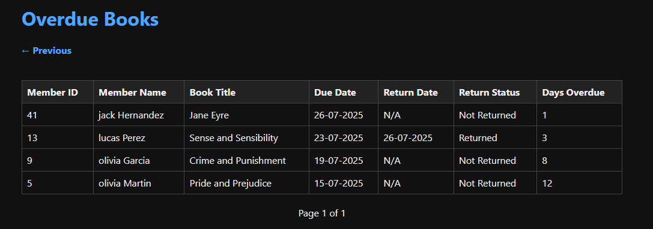
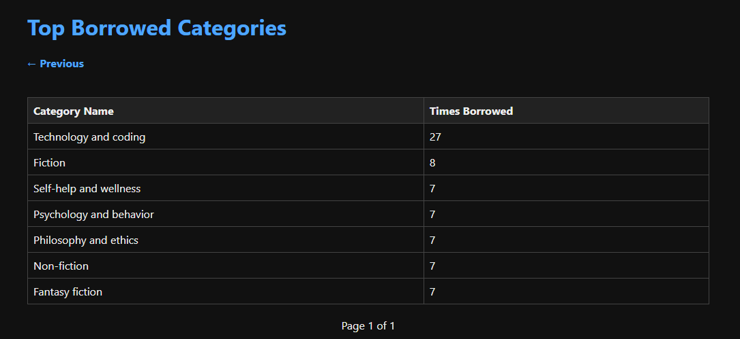
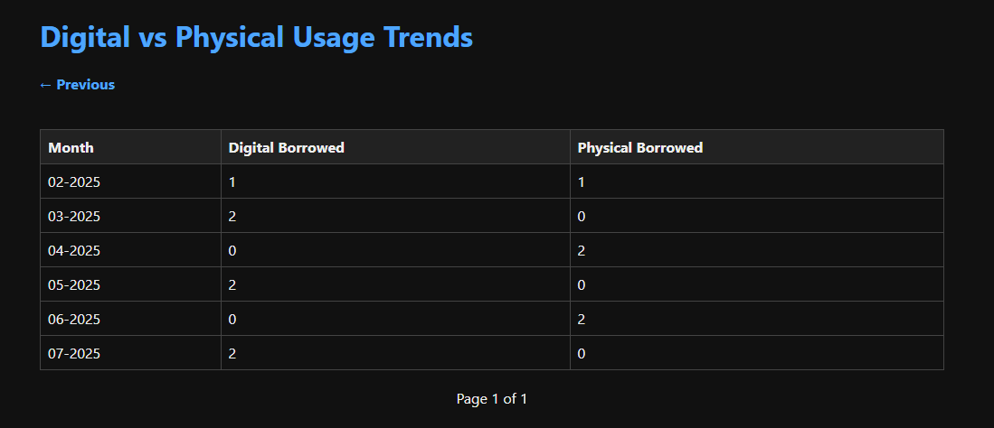
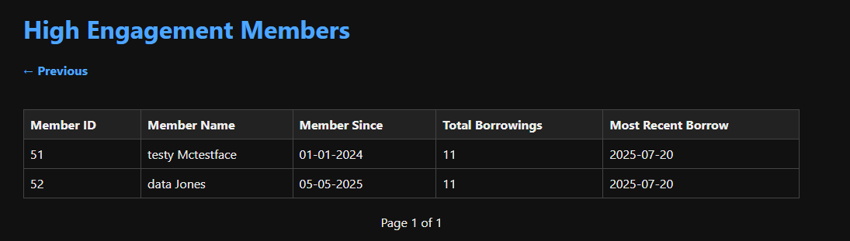
11
"JustLee: Where data shapes direction."
Notes:
S?: “Here are a few more examples of how these records might look like for you if you decide to work with us”
S?: “We made sure to cover any of your record keeping habits you already have, while also providing new details that may be beneficial for
a growing successful library”
S?: “Our Digital versus Physical usage trends allow you to compare which books may be getting more attention online than in person, making the process of
finding what books people want simple”
S?: “As a final point, we would like to show you our database in action”

Slide 13
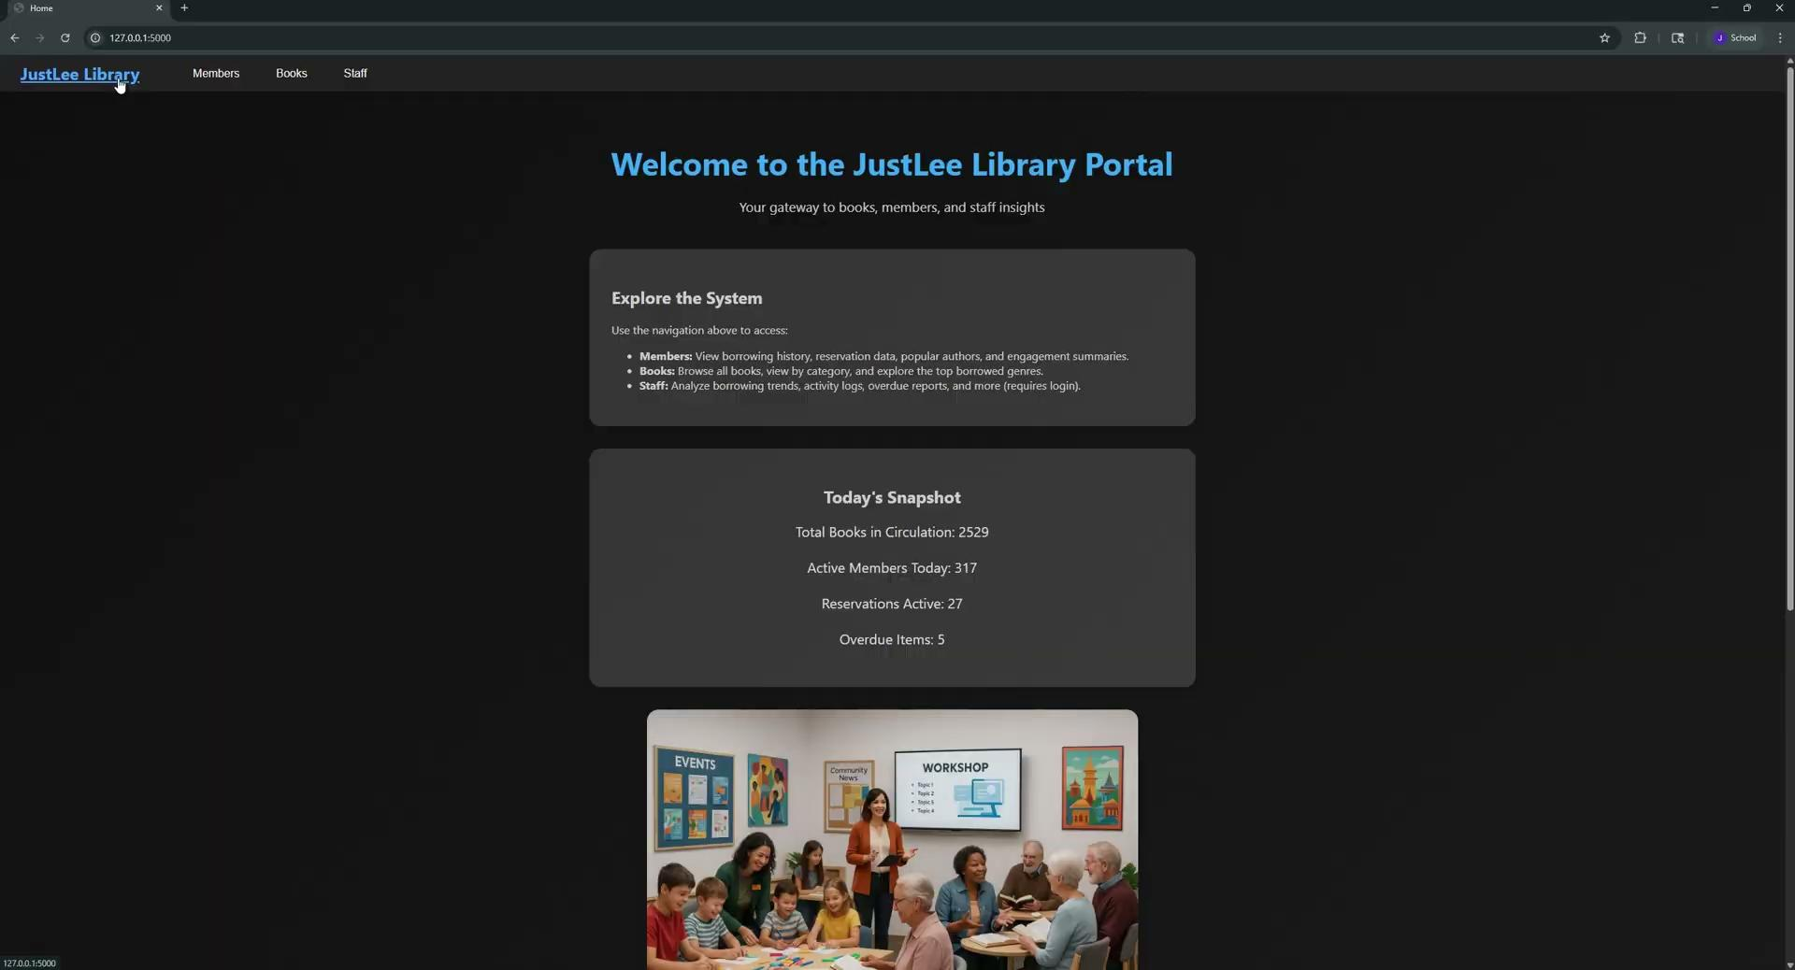
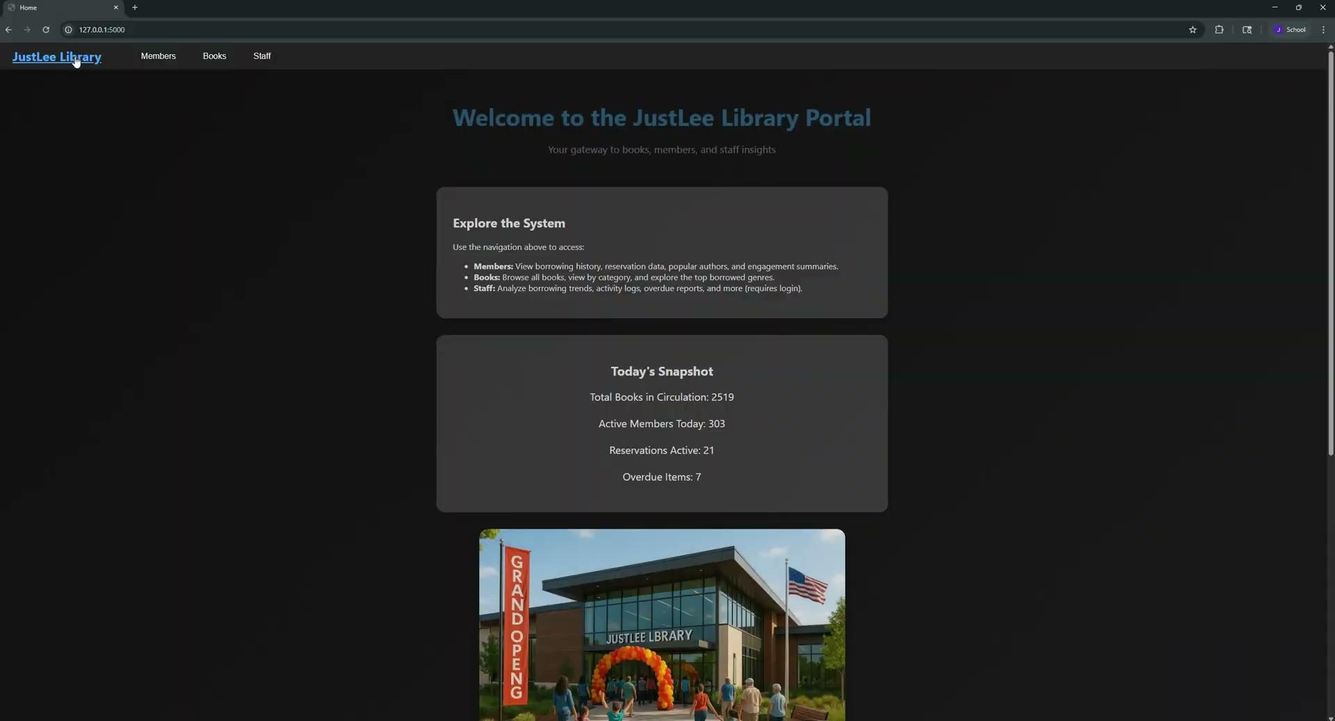
12
Staff Portal View
Internal dashboard for managing borrowings, reservations, and member activity.
" JustLee started with a question: What if libraries could do more?
Our answer?
Empowering Libraries with
Smarter, Simpler Access. ”
Member Portal View
Personalized access to books, reservations, and library events.
Notes:
S3: "We didn't just build a system. We built control, consistency, and clarity.”
S1: “Our responsibility is to ensure everything is up to standard in today’s increasingly tech-driven world.”
S4: "While others offer features, we offer foresight. Our system gives libraries the tools to grow without growing pains."
S2: "So the real question is: how soon can we get you set up?"

